Slide 1
DV8k - A ranked “core” and “mid-frequency” level 8000-word list:
compilation, justification, and validation
Nigel P. Daly
PhD candidate, NTNU
(TAITRA ITI Business English Trainer)
March 11, 2017

Slide 2
Contents
Purpose for creating the wordlist
Methods
6 Steps in wordlist compilation
Results
Interrater agreement & Parts of speech ratios
Cross-comparison of wordlists (BNC, BNC+COCA, CEEC, GSL, NGSL)
Discussion
Cross-comparisons - difficulties involved
Initial validation evidence
Limitations
Future research
Q&A

Slide 3
The importance of Wordlists
Language ability is largely a function of vocabulary size (Alderson, 2005)
Vocabulary is a key indicator language ability (Laufer, 1992; Laufer & Goldstein, 2004) and reading ability (Nation, 2001; Qian 2002).
Measuring vocabulary is thus an important area in language acquisition and its research.
At the foundation of this research are wordlists like the BNC 20000-word list, the GSL (West, 1953), and the AWL (Coxhead, 2000).
Wordlists are also used in testing, like the BNC 20k in the VST (Beglar, 2010) and the CEEC’s EWRL 6000-word list for Taiwan’s university entrance exams

Slide 4
Purpose for creating the wordlist
To make an “objective” ranked wordlist of 8000 words in order to:
represent a principled ranking of words from a large corpus of a wide range of genres of authentic texts (COCA)
serve as the basis for a diagnostic vocabulary test sensitive enough to pinpoint “receptive” vocab knowledge not just between but also within 1000 levels
EFL university-aged learners - 2000-3000 words (Laufer, 2000)
So, need a sensitive measuring tool to measure vocab within 1000 levels, ie need a ranked list
Learners tend to know most frequent vocabulary first (eg Ellis, 2002; Ellis & Larsen-Freeman, 2009; Bybee, 1995, 2006)
focus on core (first 2000 words) and “extended” mid-level frequencies (2000 to 8000), which Schmitt and Schmitt (2012) have argued should be the broadened benchmarks for language learning and teaching.
Note: Guidelines for the wordlist creation are from Nation and Webb’s (2011; ch.8) recommended 6 steps.

Slide 5
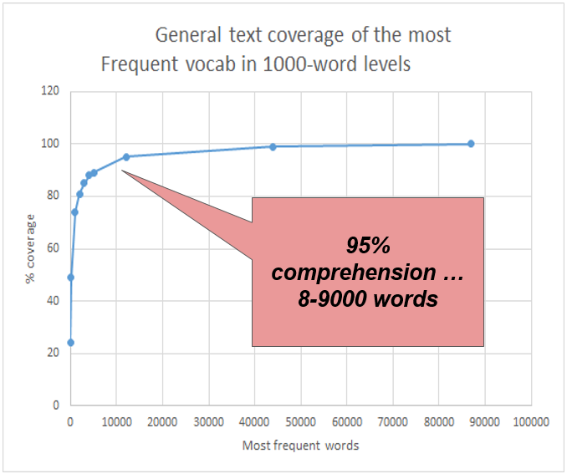
Need to go beyond core vocabulary
Core vocabulary:
80% text coverage → 2000 wordfamilies
Mid-frequency:
95% text comprehension → 8-9000 wf (Nation, 2006)
Fluent reading with adequate compreh.
98% comp → 12000 wf
NS → 20 000 wf
100% comprehension → 80000 wf (Milton, 2009)

Slide 6
Methods: 6 Steps in making a wordlist [from Nation and Webb, 2011]
Reason for list, or what RQ the list will answer
Decide unit of counting
Choose or create a suitable corpus
What will be counted as words in the list
Criteria to order the words … Rater’s compilation principles
Cross-check resulting list on another corpus or against another list to see if there are notable omissions or unusual inclusions or placements

Slide 7
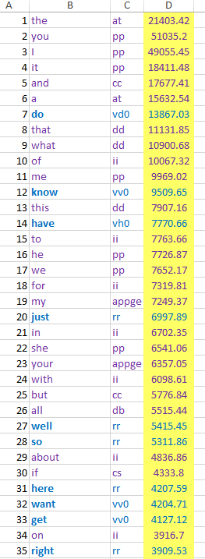
Step 1: Rationale
DV-8k
8000 words
Rank // Word // POS // Frequency
CEEC - alphabetized in1080-word levels; words and synonyms
Main reason:
Use for diagnostic vocabulary testing of ELLs for core to mid-frequency levels
No ranked wordlist covering mid-frequency levels exits
BNC - alpha-
betized in 1000- word levels; wordfamily headwords

Slide 8
Step 2: Decide unit of counting - wordfamily
“Word family” - most suitable for receptive testing purposes (Bauer and Nation, 1993)
Eg, word family headword “Care”
if learners know noun lemma (care), they can infer
verb lemma and its lemma forms (care, cares, cared, caring)
adj (careful, caring) and adv lemmas (carefully, caringly)
(they can applying word building rules and “morphological problem-solving” (Anglin, 1993), especially with context clues (Biemiller, 2005))
→ only one lemma was retained to represent a wordfamily:
reduce redundancies and overly long vocabulary lists
diagnostic tests with many redundancies will reduce its precision to estimate vocabulary size

Slide 9
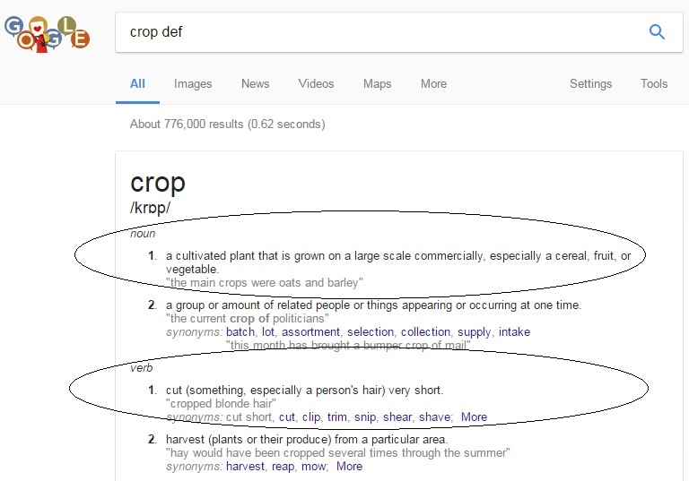
Step 2: Decide unit of counting - word/lemma of different primary meaning
The most frequent lemma form was selected to represent a word family to remove redundant terms.
Eg 1: “absolutely” = wordfamily
→ SOAP freq. rank 487 vs
“absolute” (rank 3540)
→ absolute
Eg 2: If primary meaning (Google
“def”) was different among lemmas,
they would be retained;
“Crop” = 2 wordfamilies:
- Crop n. = cultivated plant
- Crop v. = cut short
“Words” defined as having different primary meaning

Slide 10
Step 3: Choose or create a suitable corpus - COCA
COCA
largest and most well-balanced database of contemporary English
CLAWS POS tagging technology (96%) → manually checked over 2-3 months → “very good” accuracy [http://www.wordfrequency.info/100k_faq.asp];
(accuracy = crucial for making a ranked list of wordfamilies based on highest
frequency lemma forms)
2,000-word core wordlist
→ COCA’s SOAP sub-corpus (100m words) - scripts from televised dramas → more like spoken genre with more basic, daily convo language
2000-8000 wordlist
→ 400+ million word corpus: balanced genre range - spoken, fiction, magazine, newspaper, and academic journal subcorpora, with each subcorpus having over 100m words.

Slide 11
Step 4: What will be counted as words in the list
6 rules = 3 inclusion + 3 exclusion
Rule and Action | Elaboration | Examples
Rule 1. INCLUDE | lower frequency lemmas iff they have different primary meanings | “appropriate” (v) = take (sth) for one's own use “appropriate” (adj) = suitable or proper in the circumstances.
Rule 2. INCLUDE | different lemmas or lemma forms if possible confusion could arise | “cross” n. ≠ “cross” v. , “crossing” = ?? so all three were retained ("crossroads" was deleted due to its transparent meaning; see Rule 6)
Rule 3. INCLUDE | if wordform (affix) connection between diff lemmas is more uncommon and “possibly” unclear to a learner at that level (lower ranking words → higher ability level) | applaud vs. and applause perceive vs perception (cf. Bauer & Nation’s (1993) levels 5-7)

Slide 12
Step 4: What will be counted as words in the list
6 rules = 3 inclusion + 3 exclusion
Rule and Action | Elaboration | Examples
Rule 4. EXCLUDE | if the prefixes for roots can be more readily known | mis-conduct: if conduct is known, the prefix mis- indicates “mistaken” or “wrong” conduct (cf. Bauer & Nation’s (1993) level 3)
Rule 5. EXCLUDE | proper nouns with capital letters | America, Nigeria
Rule 6. EXCLUDE | compound nouns if both words are lower frequency and transparent | Bookstore, crossroads

Slide 13
Step 5: Ordering the words (5 steps)
DV-8k = 2 lists: core 2000-word list [COCA’s SOAP 100m words] + 6000 words [COCA 400m words].
Delete redundant lemmas, low dispersion and other words,
→ separately rank 2 lists (1-2000 and 2001 to 8000) according to frequency
Combine 2 lists into 1 Excel list, and then alphabetize it
Delete words from 6000-word list that duplicated ones on the shorter list
Renumber the 6000-word list and add to the 2000-word list for the final step in the creation of the DV-8k
(Over several months, several proof-readings and revisions were made)

Slide 14
Step 6: Cross-checking -- Comparing Types
Core lists (2000 words): BNC, COCA+BNC, CEEC, GSL, NGSL
Long lists (6-8000 words): BNC, COCA+BNC, CEEC, GSL, NGSL
Comparisons by type, not token or wordfamily
Eg He is fit, which is fitting for an athlete.
This sentence:
9 tokens,
8 types (2 x is = 1 type), and
7 wordfamilies … fit (adj) and fitting (adj) are traditionally lumped into 1 wordfamily despite having different meanings.
** Comparing wordfamilies → underestimates the “different” words
** Comparing tokens → overestimate if homographs are counted (crop v. and n. = 2)
“in good health”
“suitable”

Slide 15
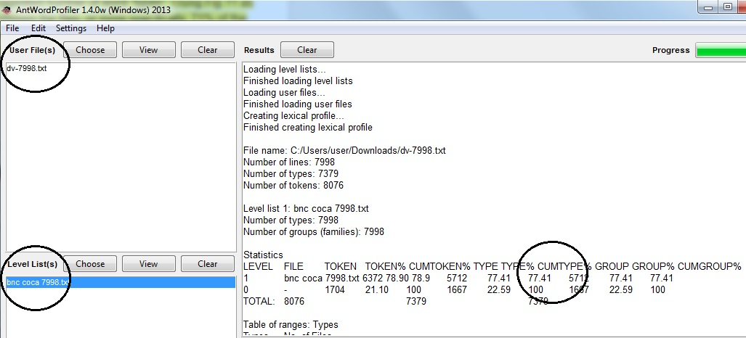
Step 6: Cross-check with other frequency lists
Core lists:
BNC, COCA+BNC, CEEC, GSL, NGSL
Long lists:
BNC, COCA+BNC, CEEC, GSL, NGSL
Eg (AntWordProfiler)
77% of DV-8k types appear on BNC COCA
Method note:
AntWordProfiler gave scores between Lextutor’s VocabProfiler (94%) and Text Lex Compare (71%)

Slide 16
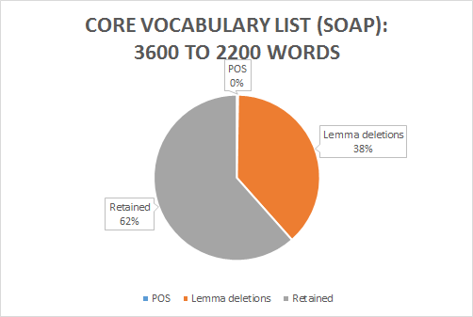
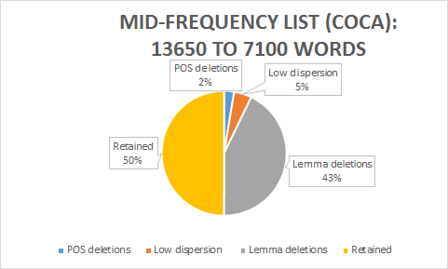
Results - Interrater agreement & deletions
Interrater agreement (1000 words): 86%
Rater: A native speaking English language teacher with almost 20 years teaching experience
CORE LIST = 1400 deleted words MID-FREQ LIST = 6550 deleted words

Slide 17
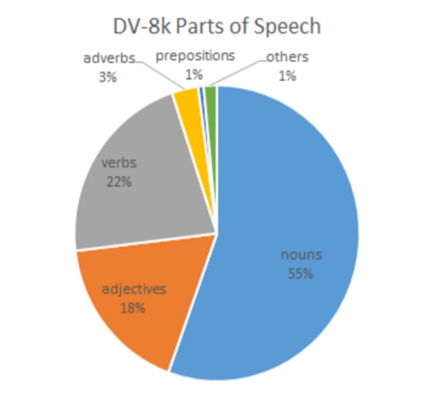
Results: DV-8k part-of-speech ratios
Parts of speech ratio
in the DV-8k
Distribution significance:
1. Indicates most common wordform representatives of the wordfamily
2. Ratio used on the diagnostic vocabulary test (each 1000 word level = same n:adj:v:adv ratio)

Slide 18
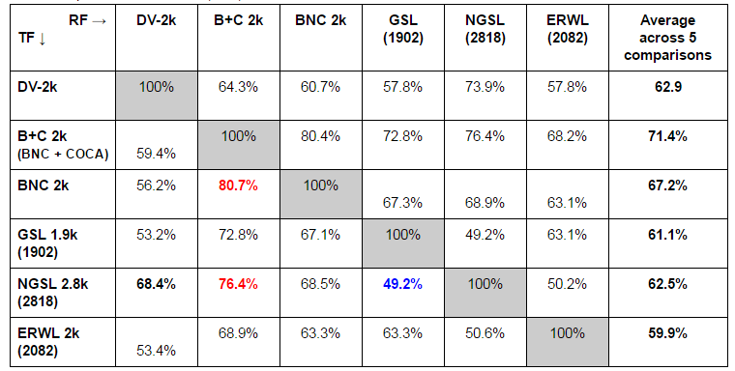
Results: Cross-checking - 6 CORE lists across 5 TYPE comparisons
Averages from 5 comparisons:
Very dissimilar
Overall avg: 59.9-71.4%
DV-2k: 62.9%
Wide Range:
49.2 - 80.7%

Slide 19
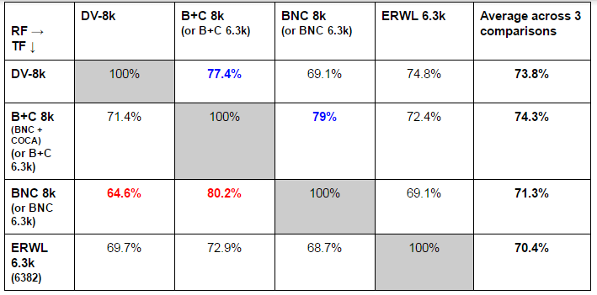
Results: Cross-checking - 4 LONG lists across 3 TYPE comparisons
Averages from 3 comparisons
Very dissimilar
Overall avg:
70.4-74.3%
DV-2k: 73.8%
Narrower Range:
64.8-80.2%

Slide 20
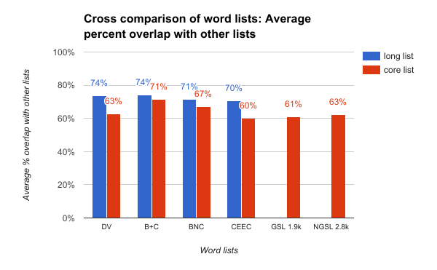
Results: Cross-checking - averages of all wordlist comparisons
Comparing all wordlists in their avg cross-comparisons with each other ...
Low percentage overlap
(reasons will be given later)
2. Long lists:
DV-8k and B+C most repeated types
3. Core lists
B+C and BNC most repeated types

Slide 21
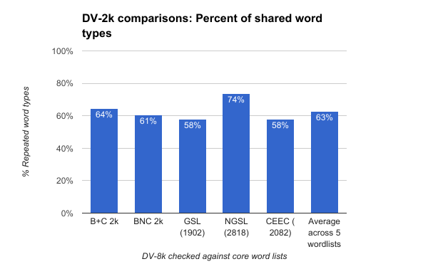
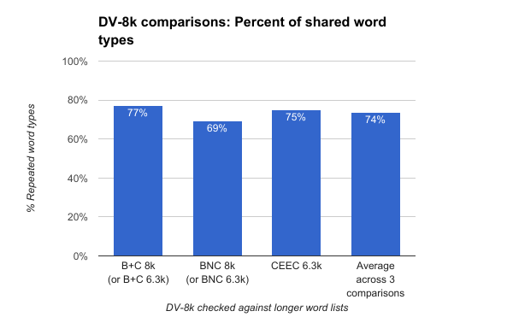
Results: DV-2k and DV-8k compared to other lists
Most similar - NGSL (lemma list) = 74%
DV-2k uses highest frequency lemma forms
Most similar - B+C = 77%
DV-8k based on COCA, like the B+C

Slide 22
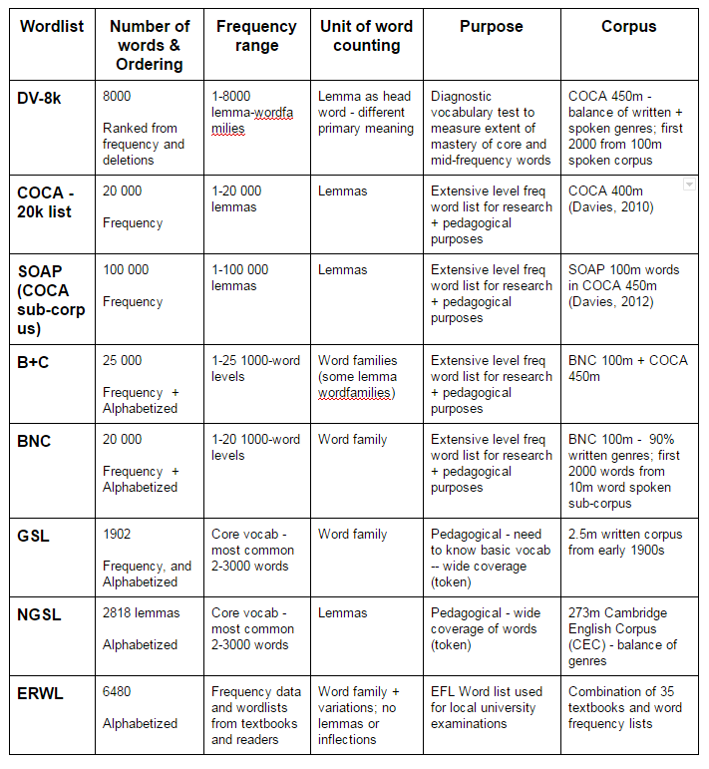
Difficulties comparing
Different lists ...
Difficult to show that one wordlist is better than another.
Comparing wordlists is imprecise … perhaps incommensurable…
Different:
Corpora
Definition of “word”
Inclusion principles
Sorting procedures
Purposes

Slide 23
Discussion
Comparing wordlists is imprecise … perhaps incommensurable…
Different corpora
Big (COCA 400m) vs small (GSL 2.5m)
US (COCA) vs UK (BNC) … bloke, aubergine ...
Old (1953 GSL) vs new (COCA) … chimney, plow …
Genre balance (COCA 400m + 100m spoken) vs imbalance (BNC 90m written, 10m spoken)
Different definition of “word”
wordfamily - GSL vs all lemmas - NGSL vs DV-8k highest freq lemma as wordfamily

Slide 24
Discussion
Comparing wordlists is imprecise … perhaps incommensurable…
3. Different inclusion principles
All words - NGSL vs no proper noun - DV-8k
4. Different sorting procedures
A-Z 1000 levels for BNC, B+C vs freq+dispersion+highest freq lemma - DV-8k
5. Different purposes
Text coverage - NGSL @ 92% vs pedagogic list - CEEC vs diagnostic testing - DV-8k

Slide 25
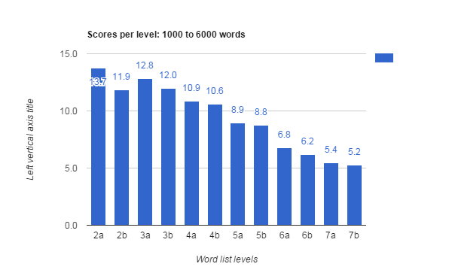
Initial Validation evidence
Level 2b (1501-2000) - poorly performing items …
Words selected too difficult?
Diagnostic Vocabulary Test
180 qs, 15-q per 500-word level [5 qs/100 words],
12 levels (Levels 2-7, rank: 1001-7000)
47 intermediate ss (TOEIC: 545 to 880; avg: 718)
Results
Steady decline with each increasing level
Expected - ELLs should be more familiar with more common words

Slide 26
Limitations
The unit of counting - lemma as representing wordfamily
Lower level learners may be unfamiliar with word inflections and derivatives within wordfamilies (Zimmerman & Schmitt, 2002; Ward & Chuenjundaeng, 2009)
This made comparability by “type” with other wordlists difficult (wordfamily lists tend to use base forms to represent wordfamilies
2. Ranking and frequency information,
Aggregating deleted wordfamily freq info would give a more accurate ranking (cf. Gardner & Davies, 2013 AVL)
Lemmas with more than one meaning (crop v = 1.cut short, 2. To cultivate plants)… meanings are not distinguished → overestimates the frequency of that “word” [def 1.] and underestimates total number of words by not recognizing some words.
COCA wordlists do not recognize multiword units (→ vastly underestimates total number of words)

Slide 27
Limitations
3. The use of corpora in wordlist compilation
What does the corpus “represent”?
Eg COCA cannot purport to represent the learner’s mental lexicon (eg different order of learning, etc) … but may be described as an objective wordlist representing most commonly encountered 1-word lemma forms in (American) English use across several genres
4. “Primary” definitions …
Secondary meanings were not considered (as mentioned in 2: crop)
How were the primary definitions decided by Google (ie The Oxford College Dictionary; Lew, 2011)?… they sometimes were not what I assumed to be more common, and they may not be the definition students are most familiar with

Slide 28
Future research
English as a lingua franca …?
The DV-8k is based on authentic and professional published English language texts in the USA. How does its rankings and frequencies resemble or differ from those from more varied and intercultural sources (Web corpora; ELF, etc)?
Aggregating word frequencies …
Future approaches to create a wordlist of lemma-families (as in this study) can benefit from aggregating the frequency info from the deleted semantically redundant lemmas and lemma forms (cf. Gardner and Davies, 2013)

Slide 29
Future research
The CEEC wordlist for Taiwan’s entrance exams
15+ years old, based on several wordlists and used dictionary frequency information.
Is it time to update this list with more accurate frequency information for sources like COCA or the BNC-COCA combination? How can a frequency approach be balanced with pedagogical need (eg survival English; localized English, etc)?
Current tools massively underestimate extent of “possible” word knowledge …
Multiword phrases with a singular meaning as is words with more than one definition (Cobb, 2013). These should all be treated as individual words and incorporated into currently existing wordlists.

Slide 30
Conclusion
The purpose of this list is for diagnostic vocabulary testing, an under-researched area.
Corpus and computer technology are ever improving … Big data is getting bigger
These advances are leading to better tools to teach and assess students.
It is time for finegrained and personalized Diagnostic language learning, tracking and testing …
For this, wordlists will play a crucial, but perhaps unacknowledged, role.

Slide 31
Q&A
This paper has 4 aims:
to argue for the need of a ranked wordlist of core and mid-level vocabulary for English language learners (ELLs);
present the compilation methods of making a list of 8000 word families;
compare the list with other existing wordlists, such as Nation’s BNC word lists, the 1900-word General Service List, the 2800-word New General Service List, and Taiwan’s 6480-word CEEC list; and
provide preliminary validation evidence.
DV-8k is ranked
other wordlists have lumped words into 1000 bands (e.g., Nation’s BNC/COCA 25000 word list used in the range program) or special functional grouping, like the Coxhead’s AWL.
Most ELLs only know around 2000 words, so wordlists based on 1000 bands are a blunt instrument if used in diagnostic tests like the Vocabulary Levels Test (VLT) to measure vocabulary mastery at these levels.
The first 2000 words → COCA’s SOAP wordlist (corpus of 100 million words from TV scripts),
6000 → COCA’s wordlist from a 400-million-word corpus composed of a wide and balanced range of genres including news, academic and fiction.
DV-8k - only lemma forms with the highest frequency and dispersion scores, manual elimination process removed lemmas sharing the same primary meaning of higher frequency forms.
86% interrater agreement when elimination criteria applied by another rater on 1000 words
Initial validation evidence comes from a pilot diagnostic vocabulary test of 180 words sampling 3 words for every group of 100 words across 6000 words.
Thank you for your attention.
Feel free to contact me:
ndaly@hotmail.com

Slide 32
References
Alderson, J. C. (2005). Diagnosing foreign language proficiency: The interface between learning and assessment. A&C Black.
Anglin, J. M., Miller, G. A., & Wakefield, P. C. (1993). Vocabulary development: A morphological analysis. Monographs of the society for research in child development Serial No.238, 58 (10 Serial No.238), 1-165.
Bauer, L., & Nation, P. (1993). Word families. International journal of Lexicography, 6(4), 253-279.
Beglar, D. (2010). A Rasch-based validation of the Vocabulary Size Test. Language Testing, 27(1), 101-118.
Beglar, D., & Hunt, A. (1999). Revising and validating the 2000 Word Level and University Word Level Vocabulary Tests. Language Testing, 16(2), 131–162.
Biemiller, A. (2005). Size and Sequence in Vocabulary Development: Implications for Choosing Words for Primary Grade Vocabulary Instruction. In E. H. Hiebert & M. L. Kamil (Eds.), Teaching and learning vocabulary: Bringing research into practice (pp.223-242). Mahwah, Nj. Lawrence Erlbaum Associates.
Browne, C., Culligan, B. & Phillips, J. (2013). The New General Service List. Retrieved from http://www.newgeneralservicelist.org.
Bybee, J. (1995). Regular morphology and the lexicon. Language and cognitive processes, 10(5), 425-455.
Bybee, J. L. (2006). From usage to grammar: The mind's response to repetition. Language, 82(4), 711-733.
Cobb, T. (2013). FREQUENCY 2.0: Incorporating homoforms and multiword units in pedagogical frequency lists. L2 Vocabulary acquisition, knowledge and use: new perspectives on assessment and corpus analysis, 79-107.
Coxhead, A. (2000). A new academic word list. TESOL Quarterly, 34(2), 213-238.
Ellis, N. C. (2002). Frequency effects in language processing. Studies in second language acquisition, 24(02), 143-188.
Ellis, N. C., & Larsen‐Freeman, D. (2009). Constructing a second language: Analyses and computational simulations of the emergence of linguistic constructions from usage. Language Learning, 59(s1), 90-125.
Laufer, B. (2000). Task effect on instructed vocabulary learning: The hypothesis of ‘involvement’. Selected Papers from AILA ’99 Tokyo (pp. 47–62). Tokyo: Waseda University Press.

Slide 33
References
Laufer, B. (1992). How much lexis is necessary for reading comprehension?. In H. Bejoint & P. Arnaud (Eds.), Vocabulary and applied linguistics (pp. 126-132). Basingstoke & London: Macmillan.
Laufer, B., & Goldstein, Z. (2004). Testing vocabulary knowledge: Size, strength, and computer adaptiveness. Language Learning, 54(3), 399-436.
Lew, R. (2011). Online Dictionaries of English. In P.A. Fuertes-Olivera and H. Bergenholtz (Eds.), E-Lexicography: The internet, digital initiatives and lexicography (pp. 230-250). London/New York: Continuum.
Milton, J. (2009). Measuring second language vocabulary acquisition (Vol. 45). Multilingual Matters.
Nation, I. (2006). How large a vocabulary is needed for reading and listening?. Canadian Modern Language Review, 63(1), 59-82.
Nation, I. S. P. (2001). Learning vocabulary in another language. Cambridge: Cambridge University Press.
Nation, I. S., & Webb, S. A. (2011). Researching and analyzing vocabulary. Heinle, Cengage Learning.
Qian, D. D. (2002). Investigating the relationship between vocabulary knowledge and academic reading performance: An assessment perspective. Language learning, 52(3), 513-536.
Schmitt, N., & Zimmerman, C. B. (2002). Derivative word forms: What do learners know?. Tesol Quarterly, 145-171.
Schmitt, N., & Schmitt, D. (2012). A reassessment of frequency and vocabulary size in L2 vocabulary teaching. Language Teaching, 47(04), 484-503.
Ward, J., & Chuenjundaeng, J. (2009). Suffix knowledge: Acquisition and applications. System, 37(3), 461-469.
West, M. P. (1953). A General Service List of English Words. With Semantic Frequencies and Asupplementary Word-list for the Writing of Popular Science and Technology. Compiled and Edited by M. West.(Revised and Enlarged Edition.). Longmans, Green & Company.

